Slide 1

Regularizing your neural network
Regularization
deeplearning.ai

Slide 2
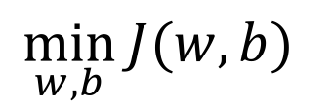
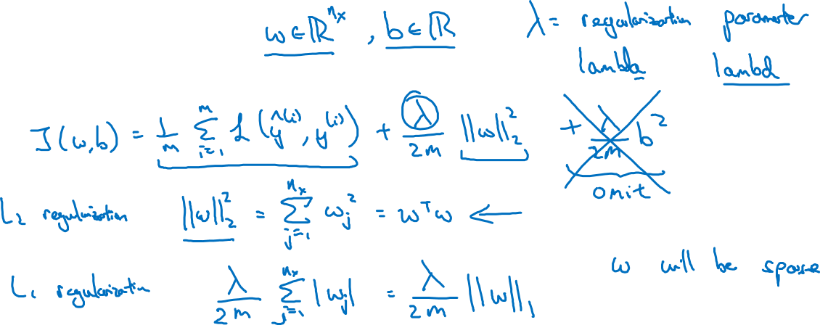
Logistic regression
$$\min_{w,b}{J(w,b)}$$

Slide 3
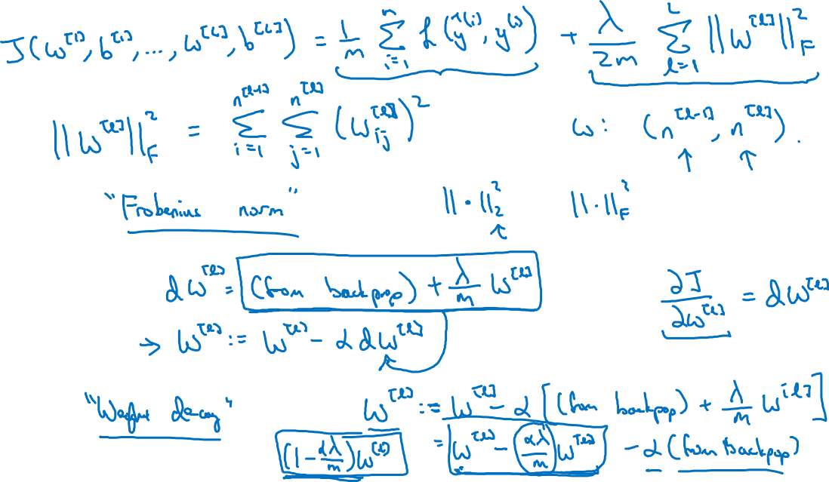
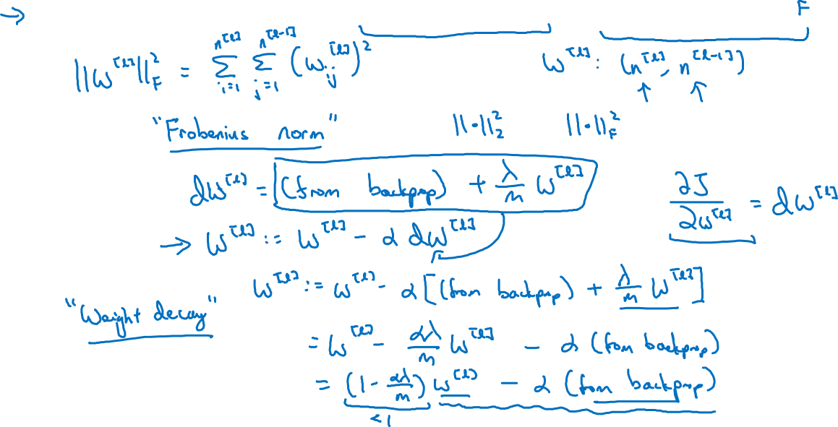
Neural network
L2 regularization is also
called Weight decay

Slide 4
Neural network

Slide 5




How does regularization prevent overfitting?
$$x_{1}$$
$$x_{2}$$
$$\hat{y}$$
$$x_{3}$$

Slide 6
How does regularization prevent overfitting?

